Slide 1


British Airways Data Science Project
Booking Completion Modeling & Skytrax Review Sentiment Analysis
Ailey Shollenberger

Slide 2


Introduction
This project includes two parts from the British Airways Forage Virtual Experience:
Booking Completion Modeling: predicting which customers complete their booking using 50,000+ historical records.
Skytrax Review Sentiment Analysis: scraping and analyzing customer reviews to understand satisfaction drivers.
Skills: Python, Pandas, scikit-learn, BeautifulSoup, NLTK, WordCloud, data storytelling.

Slide 3



Key Insights – Booking Data
Booking Completion Findings:
Longer purchase lead time → higher completion
Mobile vs Web channels behave differently
Add-on selection (meals, seats, bags) = stronger booking intent
Modeling Summary:
Random Forest classifier
One-hot encoded features
Feature importance reveals top behavioral predictors

Slide 4
Key Insights – Skytrax Reviews
Sentiment Findings:
Positive > Negative, neutral uncommon
Reviews are often extreme (very good or very bad)
Common Themes:
Staff service
Comfort & seating
Delays & cancellations
Onboard experience

Slide 5
Visual Summary of Customer Behavior & Sentiment

Slide 6
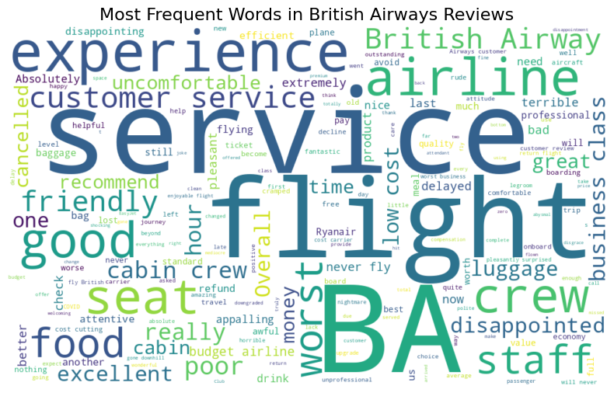
Word Cloud (main themes)

Slide 7
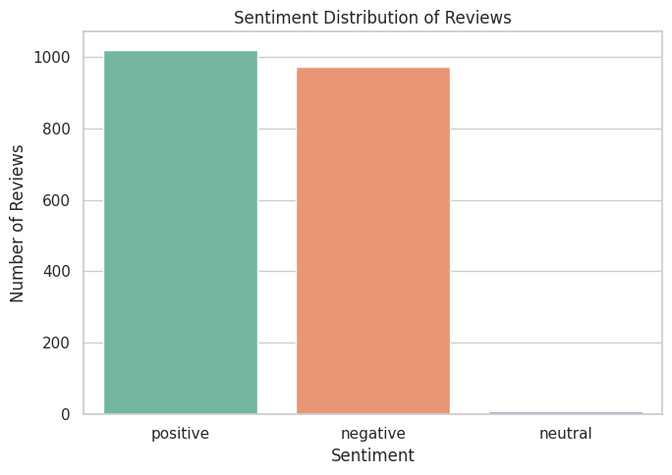
Sentiment Distribution Chart

Slide 8
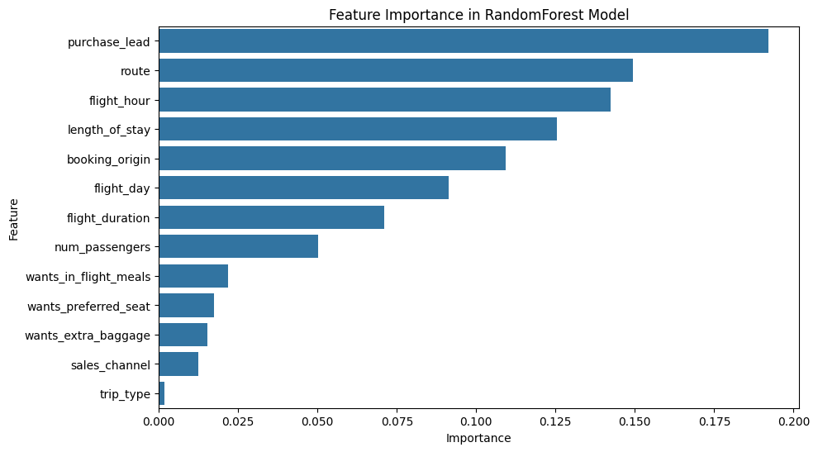
Booking Feature Importance Chart

Slide 9
CONCLUSION This project combines machine learning and natural language processing to analyze both structured booking data and unstructured customer reviews.
Key takeaways:
Booking behaviors (lead time, add-ons, channel) strongly influence completion.
Customer reviews highlight recurring positives (staff, comfort) and negatives (delays, inconsistencies).
Together, these insights provide a fuller understanding of British Airways customer experience and opportunities for improvement.
Contact: Ailey Shollenberger · GitHub: github.com/aileys

